Slide 1
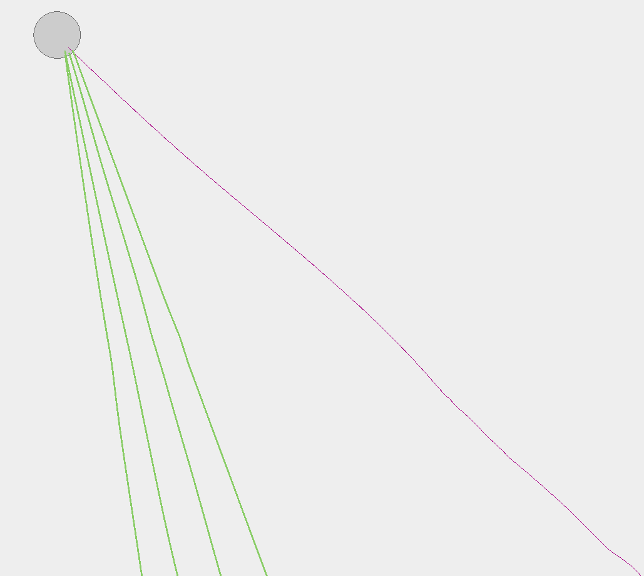
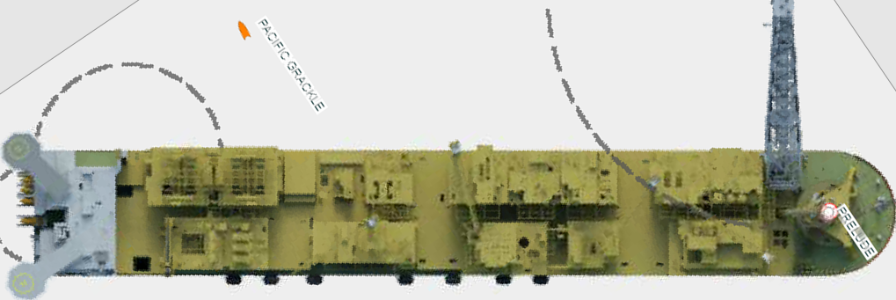
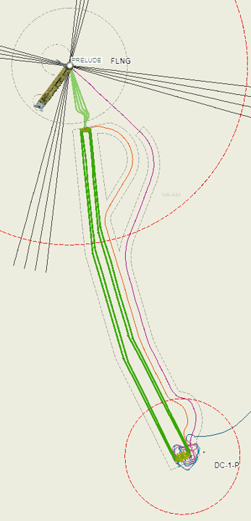
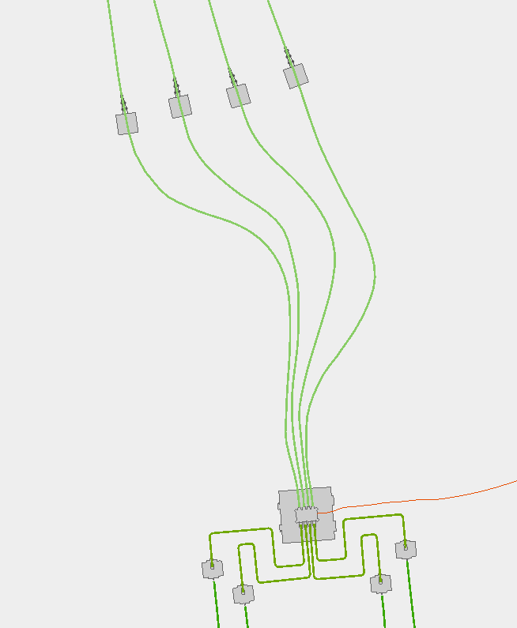

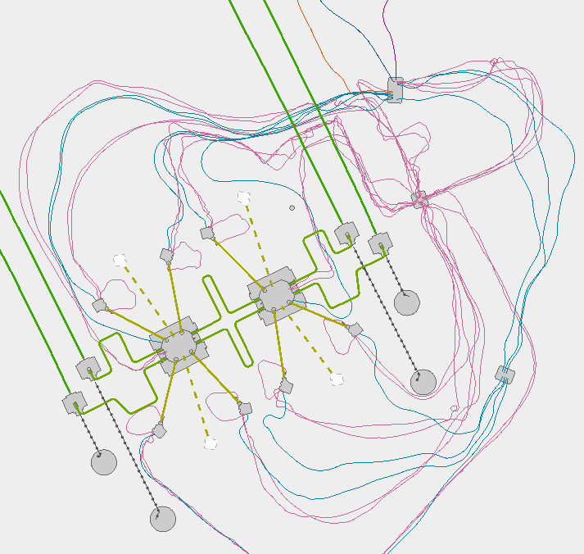
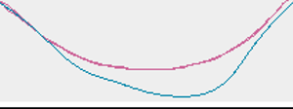
FLNG Turret
Not included
Figure 5
Flexible Riser 8 7 6 5
Umbilical
Riser Heel
Anchors
Riser Base Manifold
ESFL
RJ-04
RJ-01
PLET42
PLET12
RJ-03
RJ-02
PLET32
PLET22
BT1-2
To Onshore
BT2-2
Fibre Optic
Cable
BT3-2
FL-001
FL-002
CTA
BT4-2
BT2-1
BT1-1
FL-003
FL-004
UTA-1/HDM-1
BT4-1
BT3-1
PLET21
UTA-2/HDM-2
P4
P3
PLET11
P5
MJ-02
PM-E
P1
PAP- 1
PM-W
MJ-01
PLET31
P7
P8
UTA-3/EDM-1
PLET41
P6
PAP- 2
PAP- 4
PAP- 3

Slide 2
Prelude Subsea System Asset Integrity Status Dashboard, 2020, rev 2
Figure 1
Not included
PRODUCTION SYSTEM
DISTRIBUTION SYSTEM
TOPSIDE
RCVs [not in scope]
SPCU
MEG
ASD
CI
PSDVS
MCS
HPU
ESDVS
SWIVEL
VGMS
RISERs/UMBILICAL
RISER 8
RISER 7
RISER 6
RISER 5
POWER/COMMS
HYDRAULIC
MEG
CHEMICAL
UMBILICAL
AU.PRL.051-HDM-001 609
AU.PRL.051-UTAJ-001 611
AU.PRL.051-UTA-001 601
AU.PRL.051-ESFL-001 612
SUBSEA
RBM
ESFL
HDM-1
UTAJ1&2
UTA-1
SFLS
AU.PRL.051-UTAJ-002 622
AU.PRL.051-SFL-003 610
SFLS
RJ-04
AU.PRL.012-SFL-101 194
SFLS
EFLS
FIBRE OPTIC
AU.PRL.051-SFL-002 604
PLET42
RJ-01
PLET21
AU.PRL.051-EFL-002 606
FL4
PLET32
RJ-03
RJ-02
PLET22
FL1
FL3
FL2
AU.PRL.051-UTA-002 620
BT4-2
BT3-2
BT2-2
BT1-2
AU.PRL.051-UTA-003 630
P5
P4
P3
UTA-2
HDM-2
UTA-3
EDM-1
BT4-1
BT3-1
BT2-1
BT1-1
SFLS
EFLS
AU.PRL.051-EDM-001 631
12-WJ-101
12-WJ-301
11-WJ-401
W1
W3
MJ-02
E4
PJ-02
PLET31
PJ-03
PM-W
PM-E
PLET21
PJ-04
MJ-01
E3
E1
PJ-01
AU.PRL.SDS 846
PLET41
W6
W4
PLET11
12-WJ-601
12-WJ-401
11-WJ-301
11-WJ-101
AU.PRL.051-HDM-002 621
TERM
ASBLY
AP4
AP3
P6
P7
P8
P1
AP2
AP1
AU.PRL.011-SFL-101 143
AU.PRL.011-EFL-001A 289
Legend for Xmas Trees: Yellow border, choke issues Yellow fill for external Xmas Tree issues

